Slide 1
Generating Hybrid Cat/Human Faces
Rashmi Raviprasad
Capstone Project #2
Springboard Data Science Career Track

Slide 2
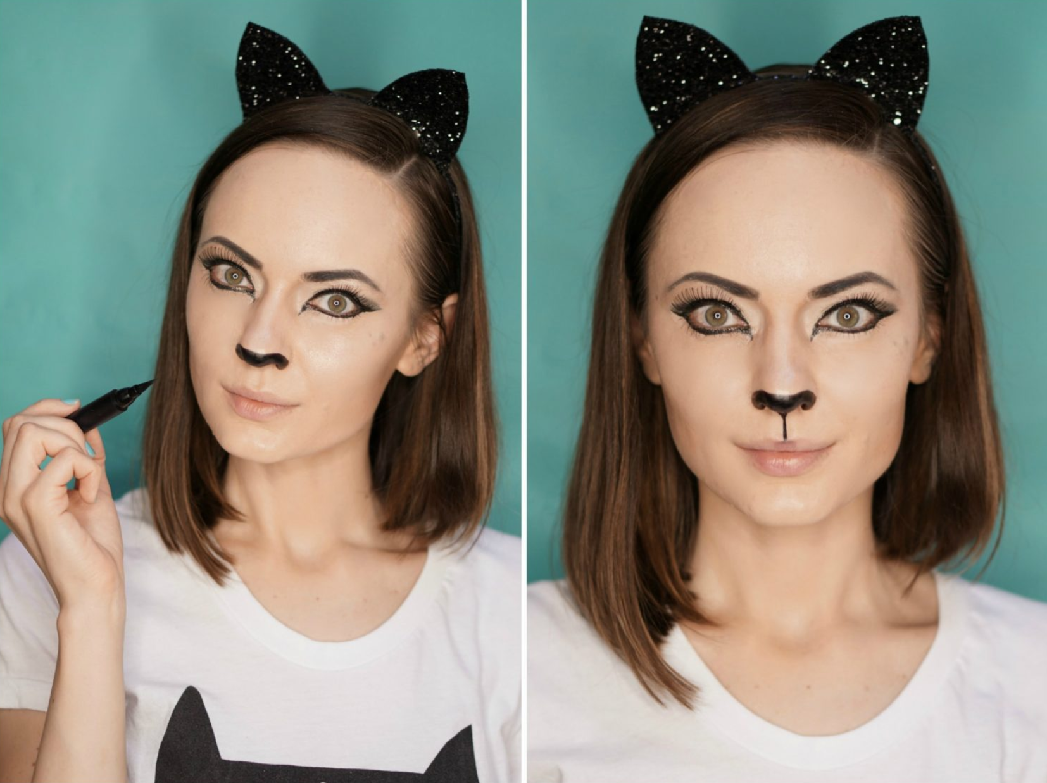
Fooling facial recognition software
Humans can recognize people even if they have “cat” features
Fun way to scrub one’s identity and avoid face tracking

Slide 3
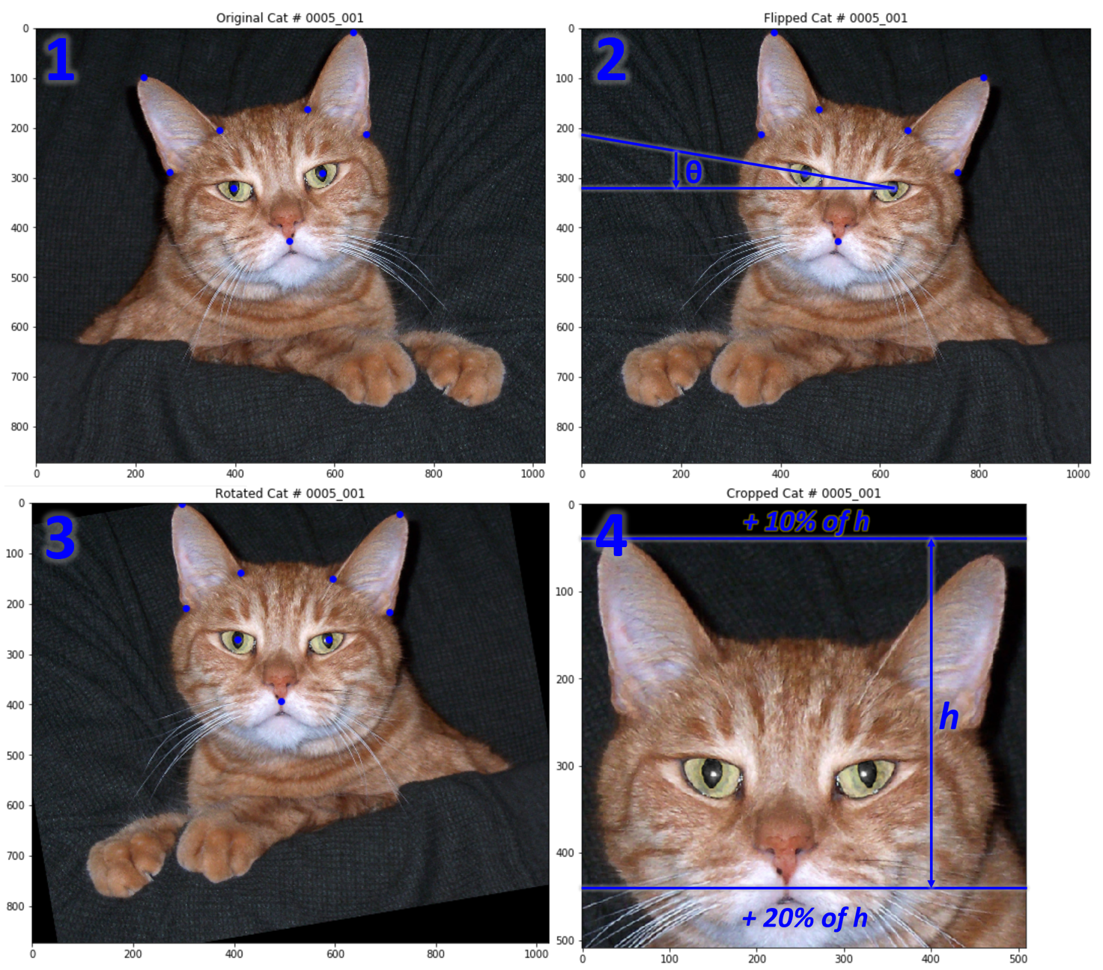
Acquiring & cleaning cat faces
Faces from Kaggle cat face dataset
Came with annotations that had coordinates of various features on face
Used annotations to center cat faces, rotate image, and crop
Resized images to 256x256 pixels
Outliers from incorrect annotations, rotation of face, and corrupted files
Almost 10k pictures

Slide 4
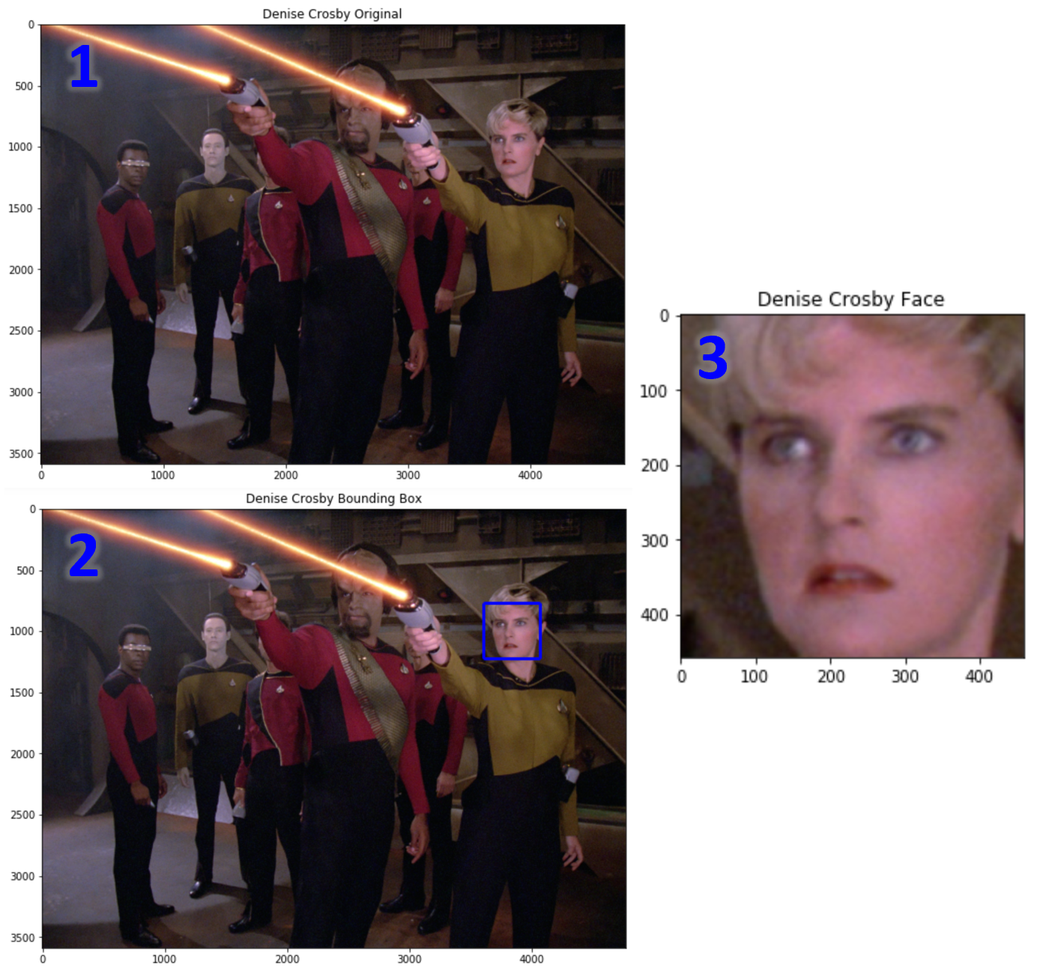
Acquiring & cleaning human faces
Faces from celebrity face dataset
Download script contained links to images & location of bounding boxes for each image
Wrote shell script to collect all pictures into one directory
About 46k images

Slide 5

Autoencoders & compression
Compresses input image into low dimension representation (latent space) using encoder
Reconstructs image as closely as possible using decoder
JPEG compression algorithm 10:1
Autoencoders are specific to the dataset they are trained on

Slide 6
Variational autoencoder
Allows access to latent space vectors in order to change reconstructed image
Only need latent space and decoder, so we can do away with encoder entirely and embed inputs directly into latent space
Proposed model architecture:
Encoder: embedding inputs into latent space
Latent space: layer with desired number of vectors
Decoder: transpose convolutional layers to reconstruct image

Slide 7
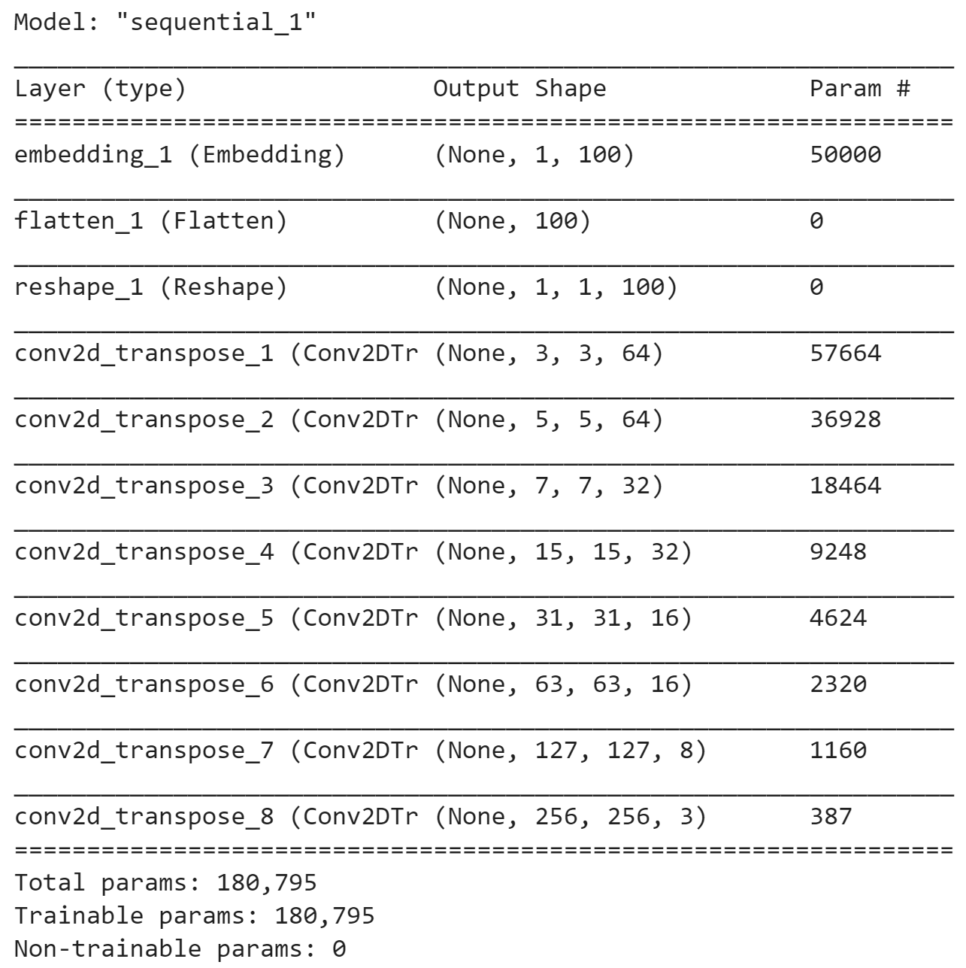
Initial model - 100 components
Compression ratio 1,966:1
Trained on full dataset using batches of 500 images (250 cats & 250 humans) for 20 epochs per batch
Aimed for 7,076 batches, totalling 141,520 epochs
Very long process and yielded unsatisfactory results even after days of training
Too much variation in dataset

Slide 8
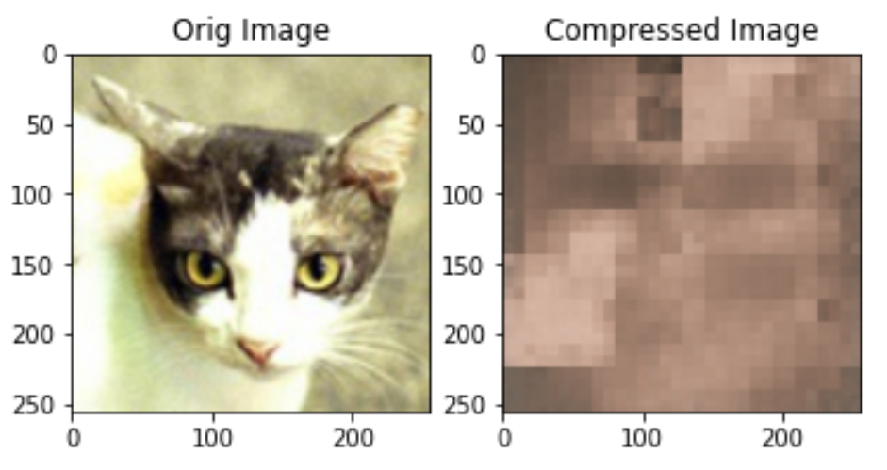
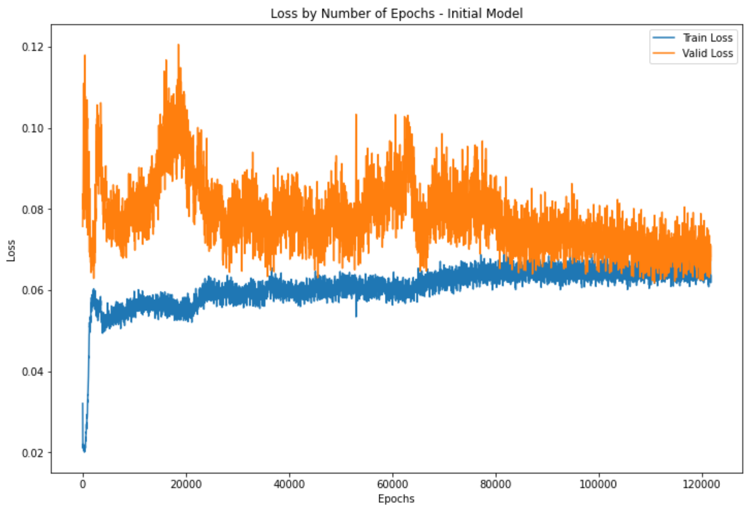
Initial model - performance
Predictions not accurate enough
Loss too high
Would not generalize well
Need to scale back

Slide 9
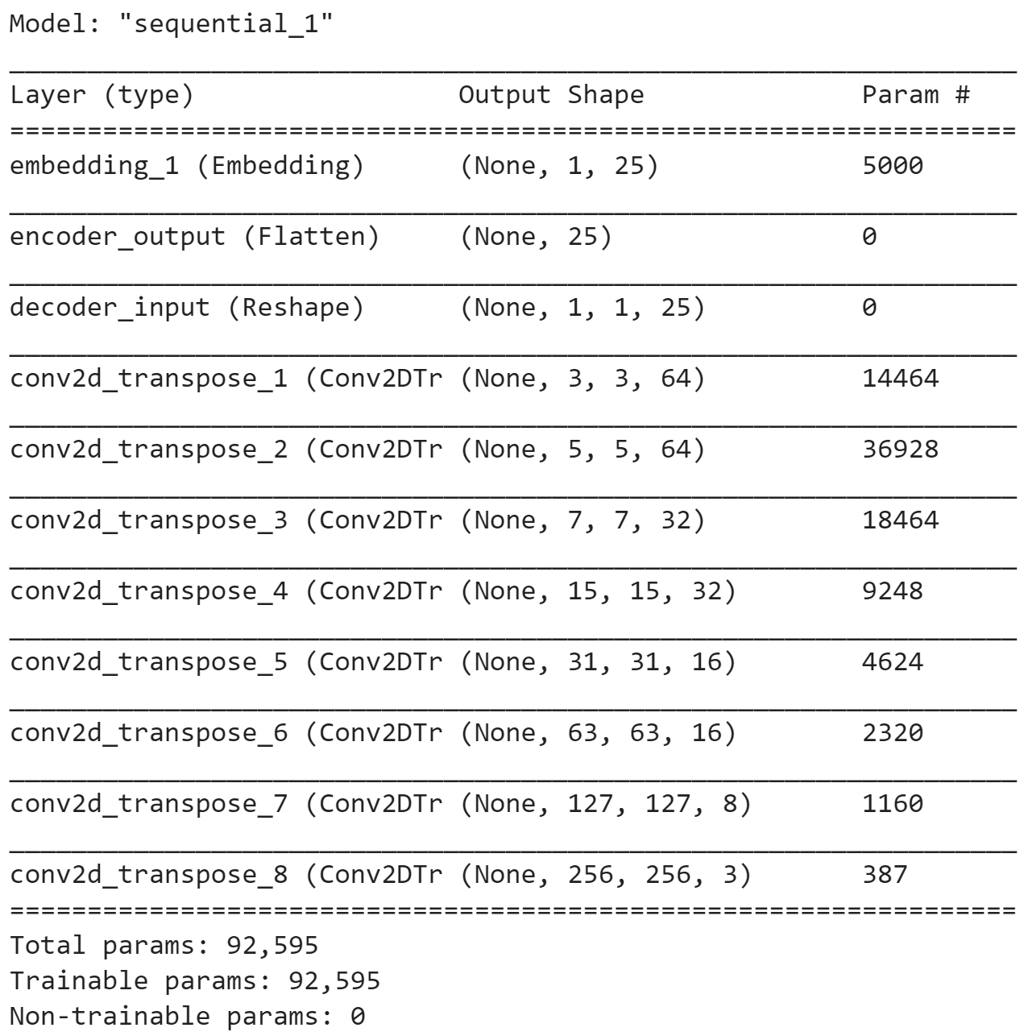
Reduced model - 25 components
Compression ratio 7,864:1
Used only 200 images (100 cats & 100 humans) for 20k epochs
Training time much shorter and better results

Slide 10
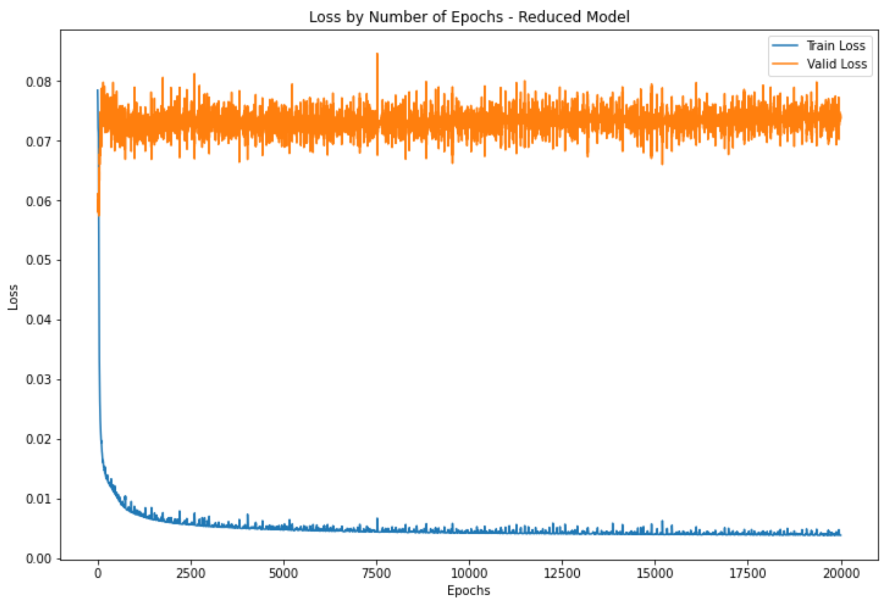
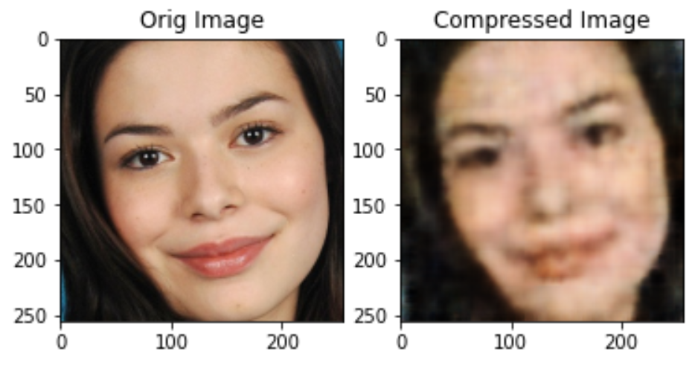
Reduced model - performance
Much better predictions
Reconstructed images are recognizable
Overfitting, but I proceeded anyway because model would only be used to detect existing patterns in dataset

Slide 11
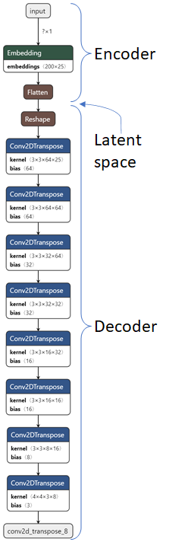
Creating application
Splitting model into encoder and decoder functions
Goal is to isolate distinct features, so need to make sure latent space vectors are independent
Performed PCA (principal component analysis) with 25 components
Did not perform well, perhaps because model’s predictions not accurate enough to isolate specific features
For now, application controls latent space vectors; this will be addressed in future versions

Slide 12
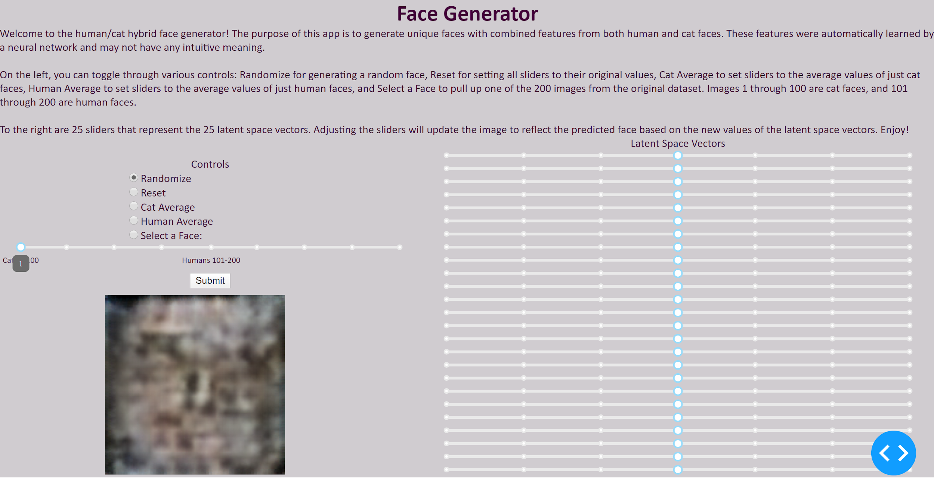
Application interface
Dash by Plotly for front end
Controls for manipulating sliders, which change values of latent space vectors and update image accordingly
Can extract meaning from a few sliders, but because of collinearity among latent space vectors, difficult to pinpoint specific properties

Slide 13
Next steps
Make improvements to model architecture
This time, include encoder layers that accept an image as input, which would allow users to upload an image
Sliders to control principal components
Implement unit testing & create CI/CD pipeline
Deploy using a Docker container or a platform such as Python Anywhere

Slide 14
Acknowledgements
Project inspired by and modeled after CodeParade’s YouTube video and source code on generating unique faces using a variational autoencoder
Cat dataset from Kaggle
Face dataset from this site
Used in research paper: H.-W. Ng, S. Winkler. A data-driven approach to cleaning large face datasets. Proc. IEEE International Conference on Image Processing (ICIP), Paris, France, Oct. 27-30, 2014.
Thanks to my mentor!
Thanks to Springboard

